Slide 1


Python Mini-project
Semester 4
To do list with voice
Created by:
Aniket Khalasi - 19DCE057
Guided by:
Prof. Sachin Patel

Slide 2
Content of presentation
What and Why new System
Project plan
Hardware and software required
Screenshot of implementation
Conclusion
Bibliography
Thank you

Slide 3
What and why new system
We use generally diary or pen paper for mark down their regular routines.
If we have some tasks on specific occasions, so if we want to remember it for that time so it is quite difficult to remember all the tasks at the time.
Now a days we all are using smartphones and personal computers.
In python we have lots of library which provides us so many facilities if we use it properly.
So one of them I have chosen gTTS library for google text to speech, so it will convert our text into speech.

Slide 4
Project plan
Now a days voice related technology is so popular in market. So I tried to identify one way in out routine to use this technology.
So I made one CLI based To do list application using gTTS library.
In this application using gTTS library it will make mp3 file of our entered tasks and after that it will asks which tasks we have completed.
After entering that tasks it will remove entered task and will tell us which tasks remaining's in our list using playsound library.

Slide 5
Hardware and Software requirement
For good experience minimum 4 GB ram pc
Python gTTS supported version
Any text editor (for better experience Jupiter-notebook)
Install gTTS library and playsound library
For deleting mp3 files os library

Slide 6
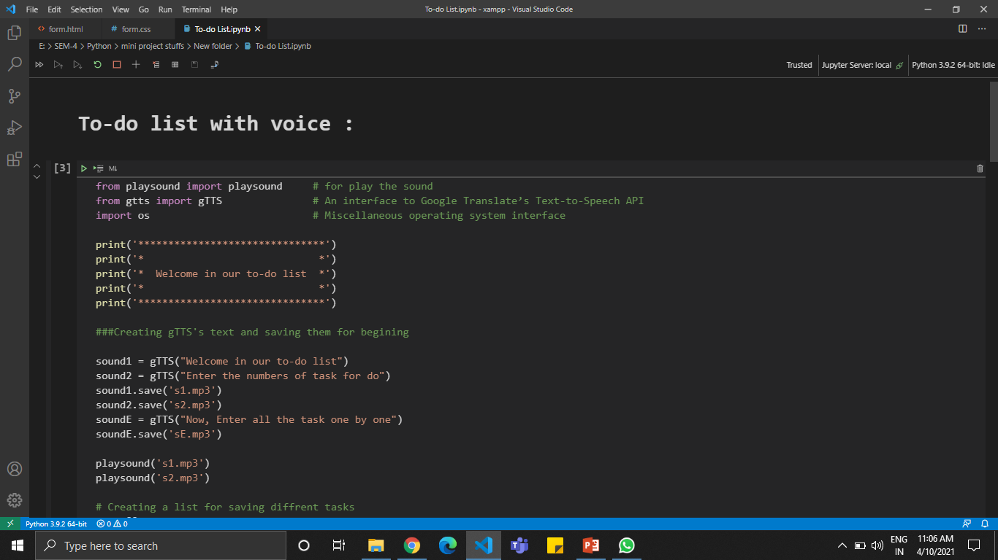
SCREENSHOTS OF IMPLEMENTATION

Slide 7
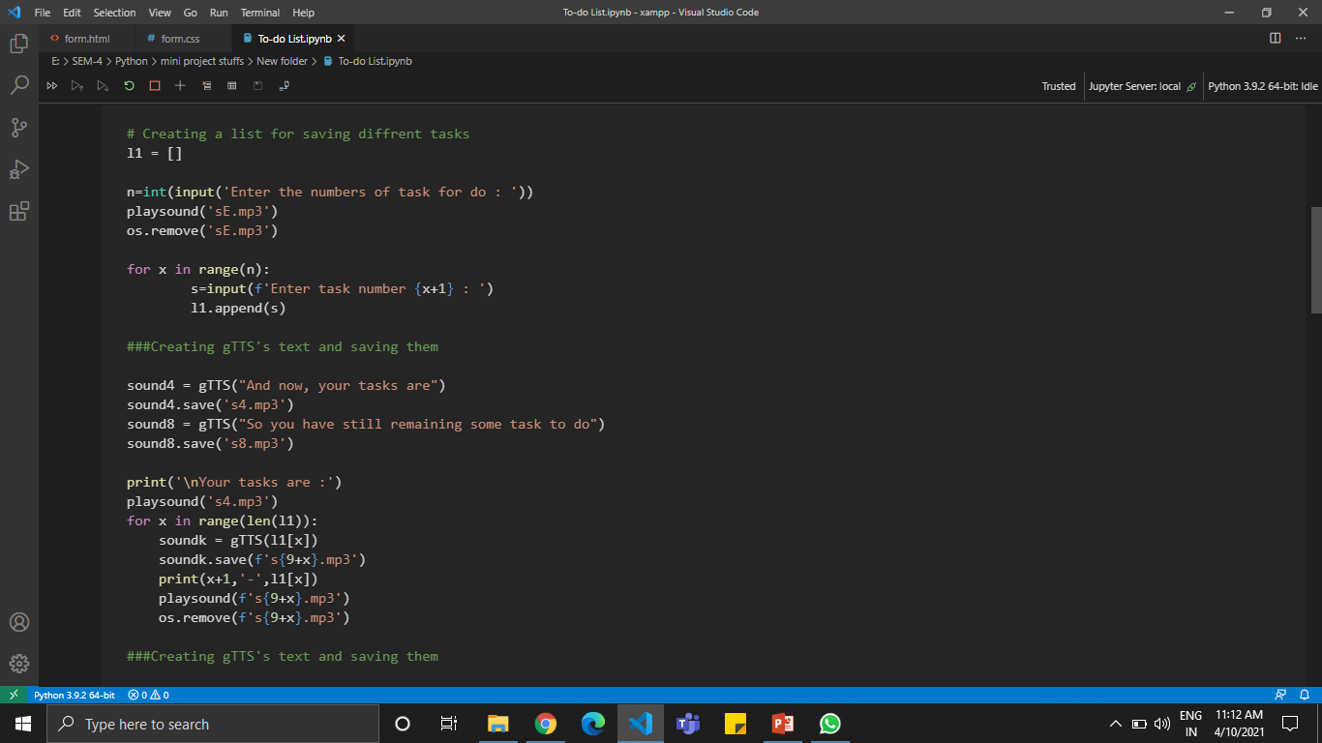

Slide 8
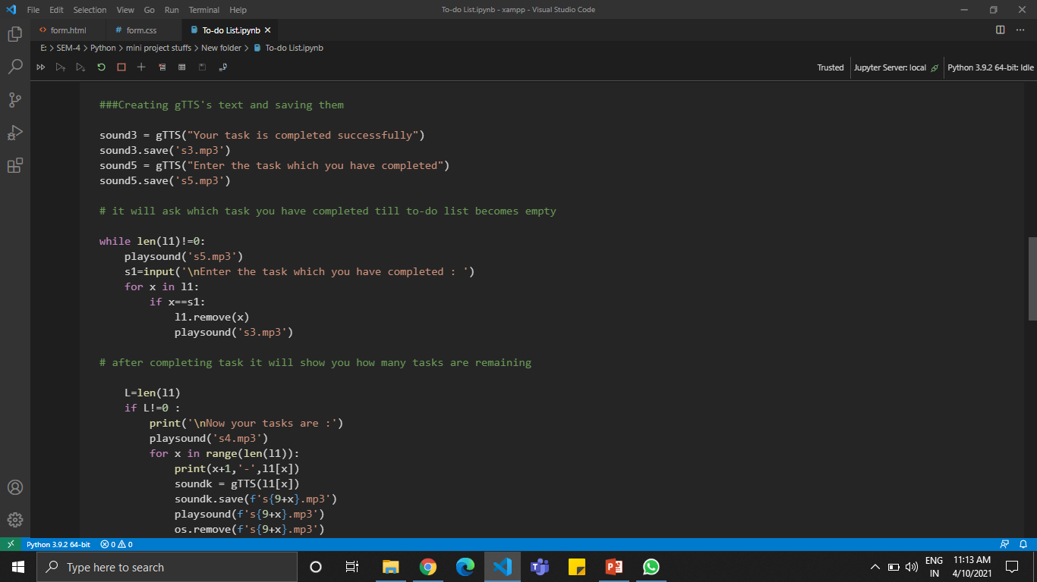

Slide 9
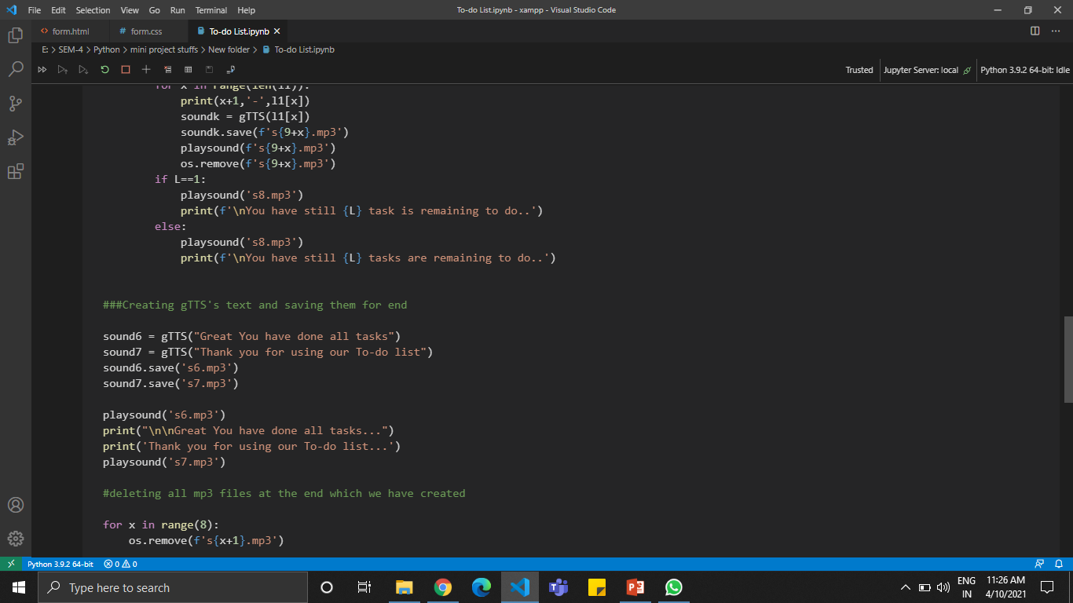

Slide 10
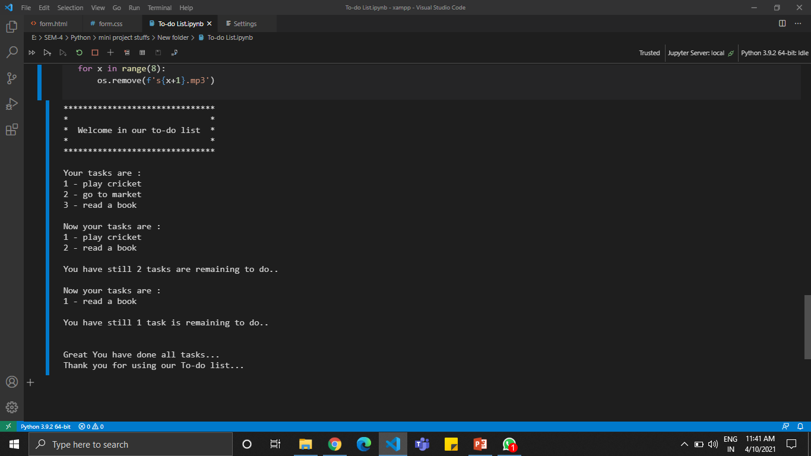

Slide 11
conclusion
From this application we can easily note down our tasks in this application.
Then after we just need to write down the task name which we have completed, so it will automatically remove it from our list and will tell us remaining tasks.
It will play good role of voice based technology.

Slide 12
bibliography
https://pypi.org/project/gTTS/
https://pypi.org/project/playsound/
https://pythonbasics.org/python-play-sound/
https://www.w3schools.com/python/python_file_remove.asp

Slide 13
Thank you

